Slide 1

Data Cleaning and Analysis in Anime Dataset
Akshaykumar Thakare

Slide 2
Summarizing the project
This study explores anime data using Spark for advanced analysis and Hive for thorough cleanup. Its primary goal is to convert unstructured data into insights that may be used to support strategic decision-making in the animation sector. Platform managers, marketers, and content creators benefit from the project's workflow, which seamlessly combines the advantages of Hive and Spark to offer insightful data and improve decision-making.
The project's transformational approach using Spark to access sophisticated analytics and Hive to ensure data reliability is what makes it so significant. Extensive documentation is an enduring asset for reproducibility and ongoing development since it fosters transparency and collaboration. Essentially, this project bridges the gap between raw data and strategic information, acting as a catalyst for data-driven innovation in the ever-evolving field of anime entertainment.

Slide 3
Key Steps
Data Cleaning Using Hive:
Filling Hive tables with unprocessed data.
Recognizing and managing absent values.
Addressing discrepancies in classification data.
Handling outliers and changing data formats.
Reducing redundancy and putting quality control in place.

Slide 4
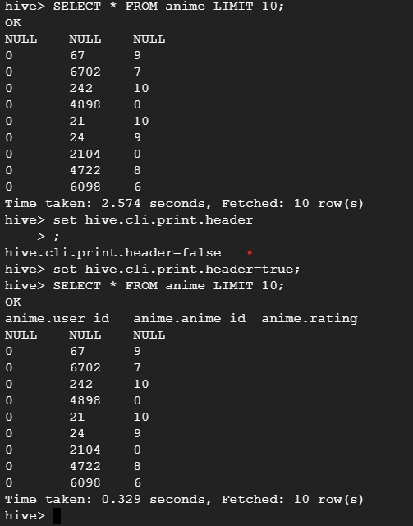
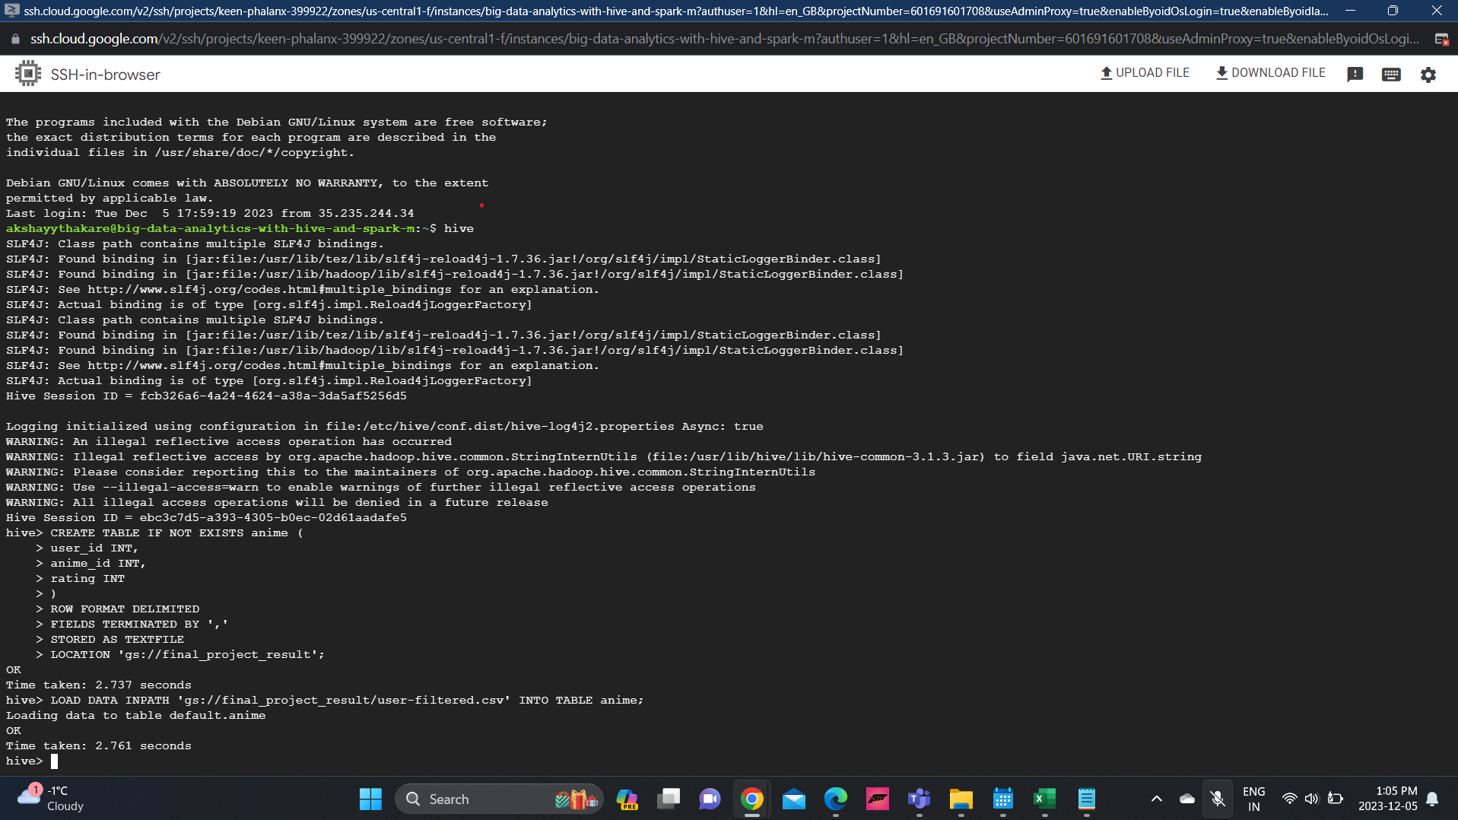
Hive

Slide 5
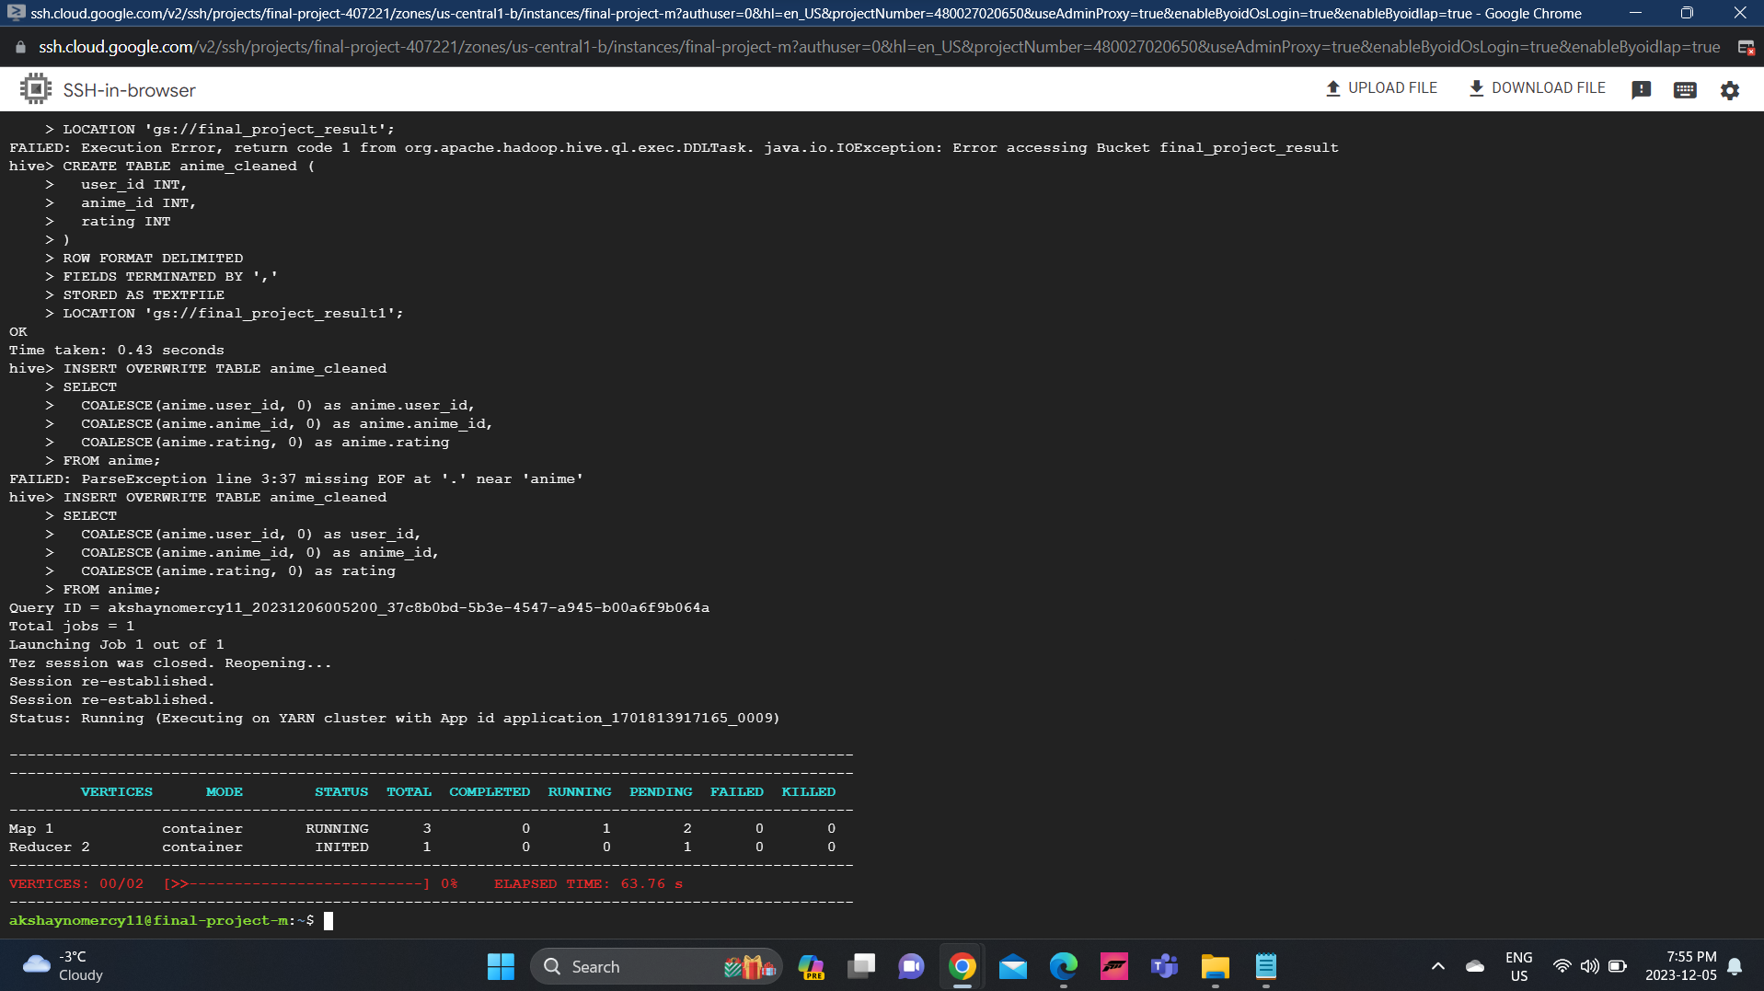
Hive Data Cleaning

Slide 6
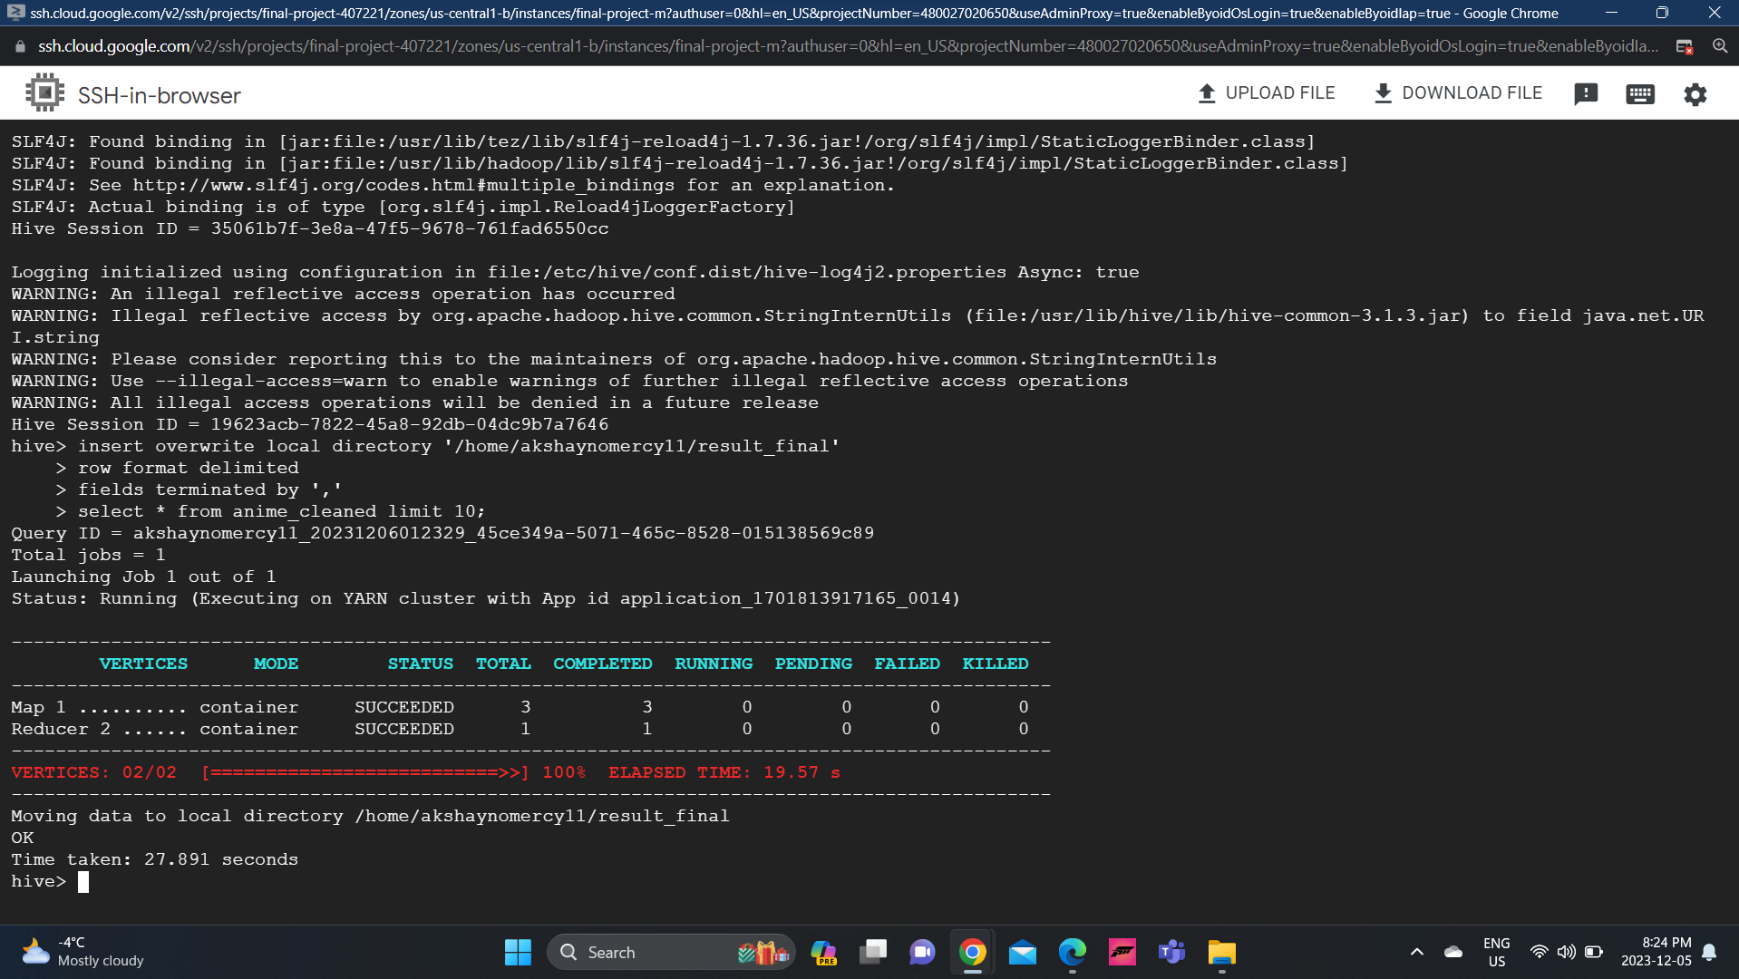
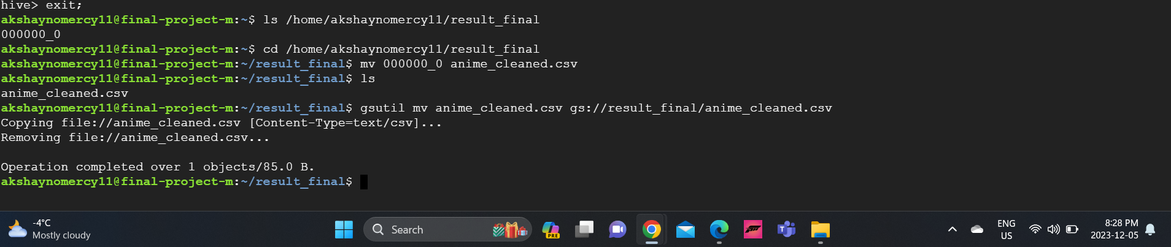
Moving data to gs bucket
Saving data to gs bucket

Slide 7
Data Processing and Analysis Using Spark
Cleaning data and loading it into a Spark Data Frame.
Utilizing exploratory data analysis (EDA) to comprehend the distribution of data.
Putting complex statistics to use, such as rating classification and user-based averages.
Extracting important information like average ratings per anime genre, top-rated anime, and user preferences.

Slide 8
Technologies Used:
Hive: For data cleaning, standardization, and initial exploratory analysis.
Spark: For advanced analytics, large-scale data processing, and visualization.

Slide 9
Key Findings: Data Analysis in Anime Dataset
User-Based Ratings Analysis:
User Preferences: Found trends in user preferences by figuring out average ratings based on users. Information about how various user groups evaluate anime content, which helps with tailored content suggestions.
Ratings Distribution and Categorization:
Sentiment Analysis: Examined the rating distribution to ascertain how people felt about anime content in general. Ratings have been categorized into three categories: High, Medium, and Low, offering a more nuanced picture of user mood.
Top-Rated Anime Identification:
Content Popularity: Based on user ratings, determined and presented the anime with the highest ratings. Information on the most well-liked and well-reviewed material, which helps direct plans for content generation and acquisition.

Slide 10
Genre-Specific Performance:
Average Ratings per Anime Category: Determined the average rating for each category of anime, exposing performance specific to the genre. Knowledgeable choices about platform placement, genre-specific marketing, and content acquisition.
Visualizations:
Data Representation: Made use of Seaborn and Matplotlib to generate visualisations. Included bar graphs showing the top ten categories by average rating as well as histograms showing the distribution of the top ten ratings.

Slide 11
Key Learnings: Data Analysis in Anime Dataset
Importance of Data Quality:
The phase of data cleansing brought to light how important it is to guarantee data quality. To produce a trustworthy dataset, imputation, standardization, and deduplication are necessary processes.
Hive for Structured Data Processing:
Streamlining structured data processing can be achieved by using Hive for preliminary data transformation and cleaning operations. Using a syntax like SQL makes managing tabular data easier.
Spark for Scalable Data Processing:
Spark's distributed computing features make it possible to process big datasets effectively. Spark's parallel architecture improves scalability, which is essential for big data analytics.

Slide 12
Key Learnings: Data Analysis in Anime Dataset
Advanced Analytics Techniques:
Understanding and applying advanced analytics techniques, such as user-based average ratings and categorization, enhance the depth of insights. Such techniques provide granular information for decision-making
Visualization as a Communication Tool:
When combined with Spark, Matplotlib and Seaborn provide strong data visualisation capabilities. A wide range of audiences can better understand difficult ideas when presented through visual aids.

Slide 13

Thank you

